Slide 1



Regional Development Indicators Module
Zintis Hermansons,
September, 2016

Slide 2
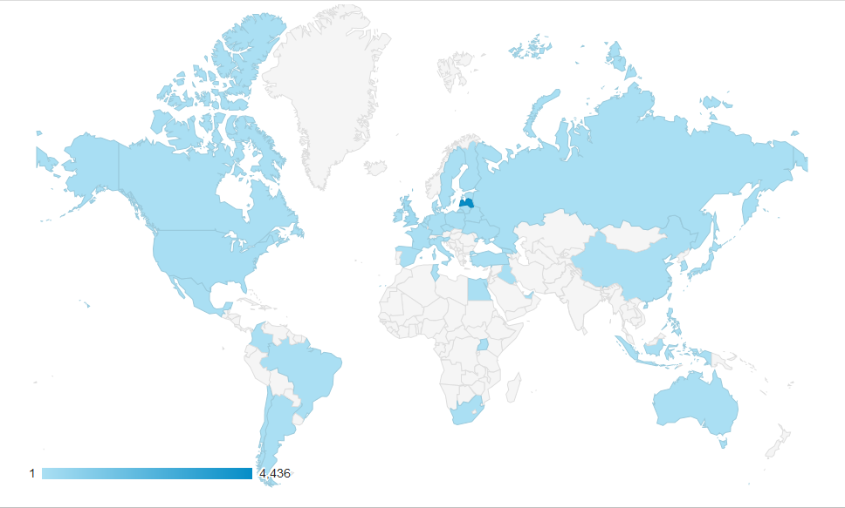
Introduction I
Have you heard about it..? www.raim.gov.lv
Geographical breakdown of the users

Slide 3
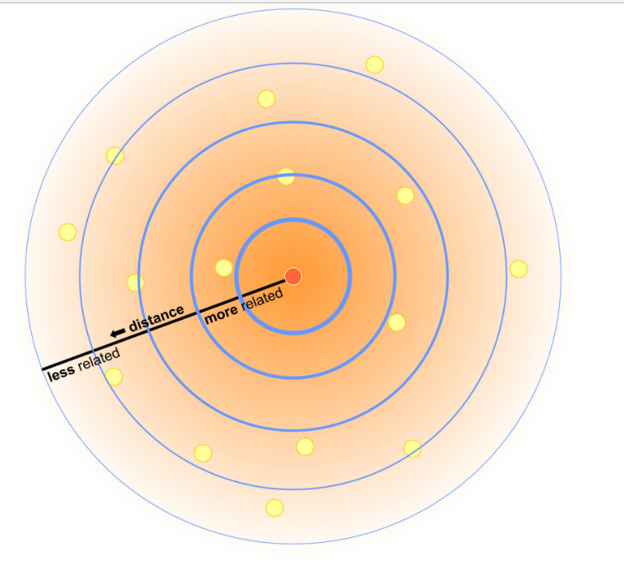
Introduction II
First law of geography:
“Everything is related to everything else, but near things are more related than distant things”.
Waldo R. Tobler, 1970

Slide 4
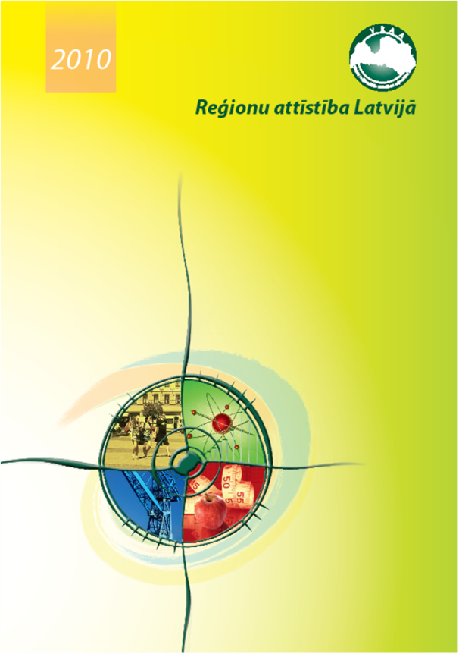
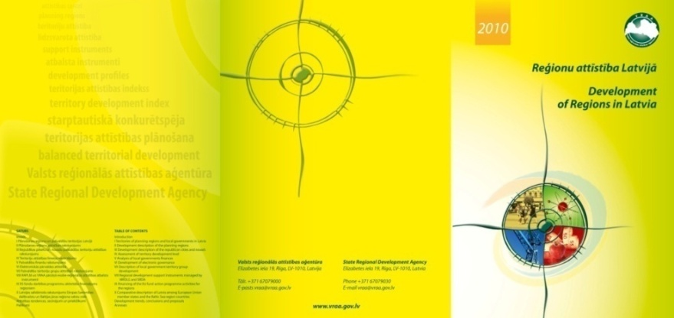
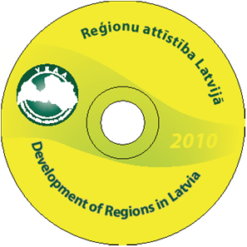
How we did territorial monitoring back in the day..
Annual publication “Development of regions in Latvia”

Slide 5
Territorial monitoring system today
Systematic approach with a legal “backing”
Regional development indicators module
Monitoring
EU investment
Development indicators
Evaluation
Territory development index
www.raim.gov.lv
Components
Analytical work

Slide 6


Regional development indicators module - essentials
In the WEB (LV/ENG/RU) www.raim.gov.lv
Since 2014
Software
Free access to everyone (pre-made content though)
Authorization – local municipalities, regions, experts

Slide 7

Content of the module
Socio-economic indicators
  36 data units with 70 basic indicators and 206 derived indicators capturing the essentials of territorial development:
    Demography
    Land
    Economics
    Social welfare
Financial investment indicators
    EU funding
    Local budget
Availability
NUTS 3/ TL 3
LAU 2

Slide 8

Data sources of the module
16 data sources

Slide 9




Cycle of information circulation
Providers of data
FTP server
Data storage
Monitoring
Loading of data
Experts
Making reports
Data analysis tool
Making reports
Regular user

Slide 10

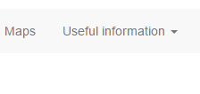
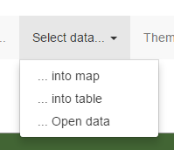
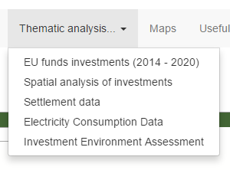
Functionality in brief

Slide 11
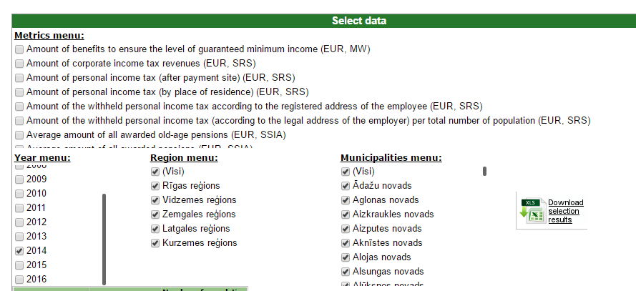
Select data for download

Slide 12
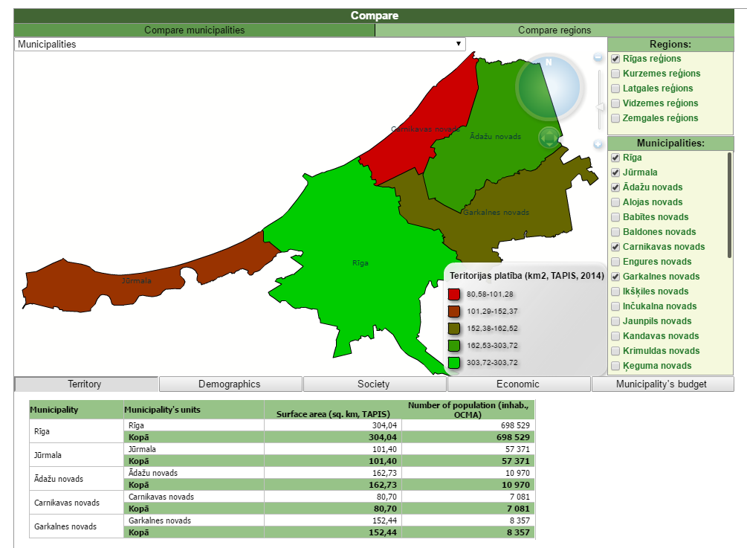
Compare any two or more municipalities

Slide 13
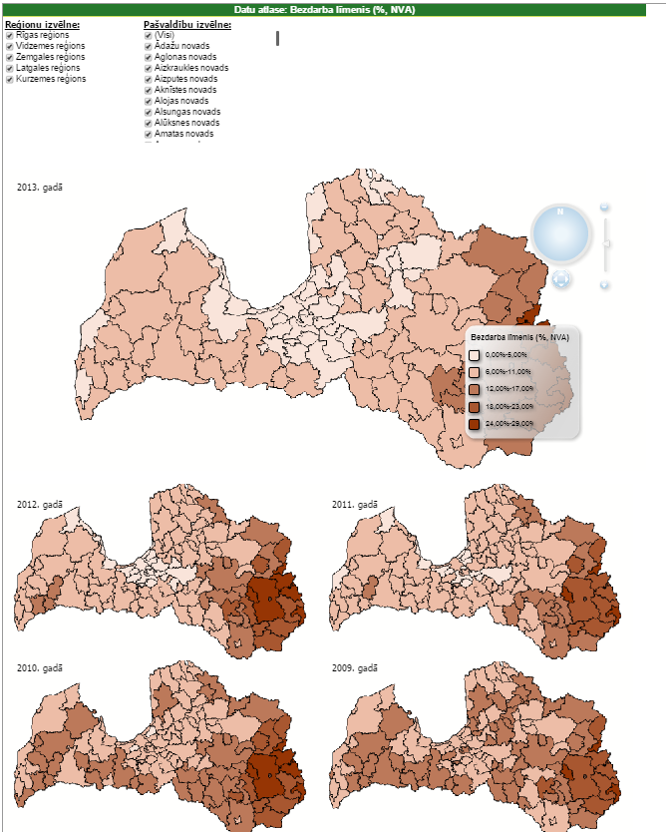
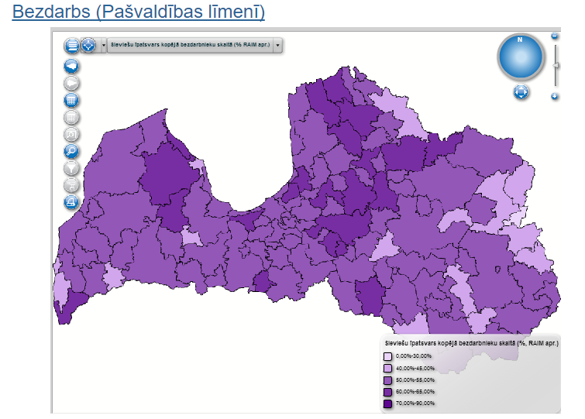
Possibility to see data mapped

Slide 14
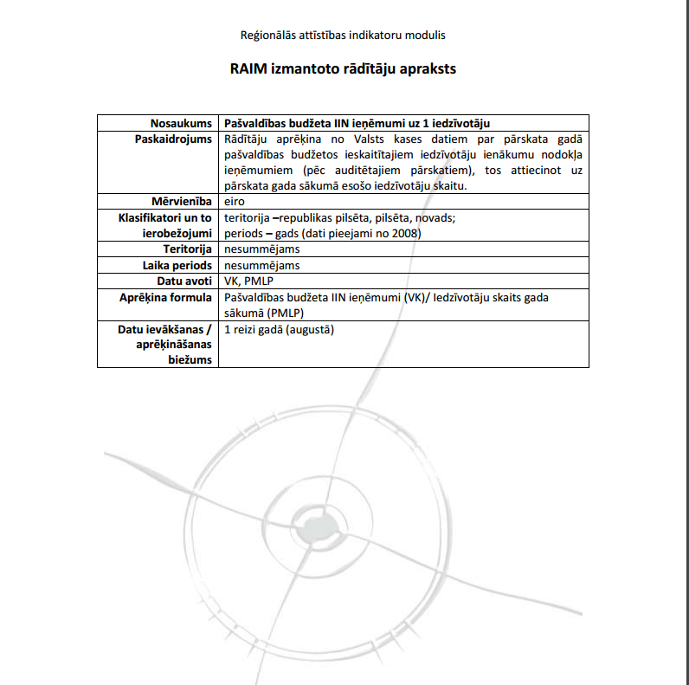
Extensive metadata catalogue
Information “Passport” for every indicator

Slide 15
Thank you!
www.varam.gov.lv

