Slide 1
Baltic Sea Region Programme 2014-2020: territorial assets and challenges
Joint Technical Secretariat
VASAB workshop „Cultivating new ideas for the territorial development of the Baltic Sea Region”
28 November 2013, Riga

Slide 2
Content:
Baltic Sea Region Programme 2014-2020
Themes addressed by the future Programme and its response to the selected territorial challenges and assets
Examples of the projects co-financed the Baltic Sea Region Programme 2007-2013
2

Slide 3
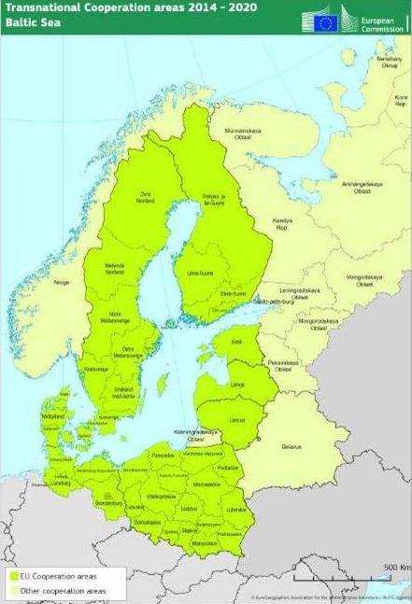
1. The Baltic Sea Region Programme 2014-2020
Supports sustainable regional development through transnational cooperation projects
Builds on territorial assets
Addresses territorial challenges
Fosters place-based growth

Slide 4
1. The Baltic Sea Region Programme 2014-2020
Cover 11 participating countries
Have a strong relationship to the EU Strategy for the Baltic Sea Region
Operate at least within the same budget
Provide up to 75-85 % co-financing on priority axis level

Slide 5
2. Themes Addressed by the Future Programme
Capacity for Innovation
Efficient Management of Natural Resources
Sustainable Transport

Slide 6
Capacity for Innovation
Territorial assets/challenges and the Programme’s response:
A wide range of research and innovation infrastructures – enhance market uptake of innovation
Diverse competencies and strengths for the generation of innovation – strengthen smart specialisation

Slide 7
Efficient Management of Natural Resources
Territorial assets/challenges and the Programme’s response:
Resources for renewable energy – increase production and use of sustainable renewable energy
Sea resources for business purposes – advance sustainable and resource-efficient blue growth

Slide 8
Sustainable Transport
Territorial assets/challenges and the Programme’s response:
Low interoperability of transport modes, incl. long distances, border crossing – increase efficiency of transporting goods and persons in north-south and east-west connections
Low accessibility of remote areas – improve accessibility of remote areas, particularly in the northern and eastern part of the BSR
Challenging sea navigation, especially in winter conditions – advance sustainable and resource-efficient blue growth
Low efficiency of urban logistics – enhance environmentally friendly transport systems at urban areas

Slide 9
3. Examples of the projects co-financed the Baltic Sea Region Programme 2007-2013
Project: BaltSeaPlan – Introducing Maritime Spatial Planning in the Baltic Sea &
PartiSEApate – Multi-level Governance in MSP throughout the Baltic Sea Region
Aim: to create a joint understanding and to further foster holistic thinking for sustainable and integrated Maritime Spatial Planning
Lead partner: Federal Maritime and Hydrographic Agency, DE &
Maritime Institute Gdansk, PL
Budget: € 3.7 million & € 1 million

Slide 10
3. Examples of the projects co-financed the Baltic Sea Region Programme 2007-2013
Project: SUBMARINER – Sustainable uses of Baltic Marine Resources
Aim: to foster the economic development by promoting new sustainable marine uses
Lead partner: Maritime Institute Gdansk, PL
Budget: € 3.6 million

Slide 11
Baltic Sea Region Programme 2014-2020: territorial assets and challenges
Elena Kolosova
Project Officer
Phone: +371 6735 0646
Email: elena.kolosova@eu.baltic.net
eu.baltic.net

